Slide 1
UNIFORM STORE
FUNCTIONALITY - CATEGORY
RAMYA C

Slide 2
MANUAL TESTING – SPRINT 1
Creation of test cases from admin end using equivalence partitioning and boundary values
1) ADMIN – ADD Category
2) ADMIN – UPDATE Category
3) ADMIN – DELETE Category
Review of Manufacturer testcases from ADMIN end
Manufacturer test case metrics

Slide 3
MANUAL TESTING – SPRINT 1
Creation of CATEGORY testcases
Execution of test cases
Defect log cycle-1 and cycle-2 performed
Creation of Issue log
Uploading all files in Github
Submission of assigned tasks in Jira
Bug reporting in Jira

Slide 4
AUTOMATION TESTING – SPRINT 2
Smoke test – ADMIN must be able to go through Category section after successful login
Sanity test – ADMIN must be able to add new Category using the ADMIN dashboard
TestNG file and Extent Report creation
Uploading all files in Github
Submission of assigned tasks in Jira

Slide 5
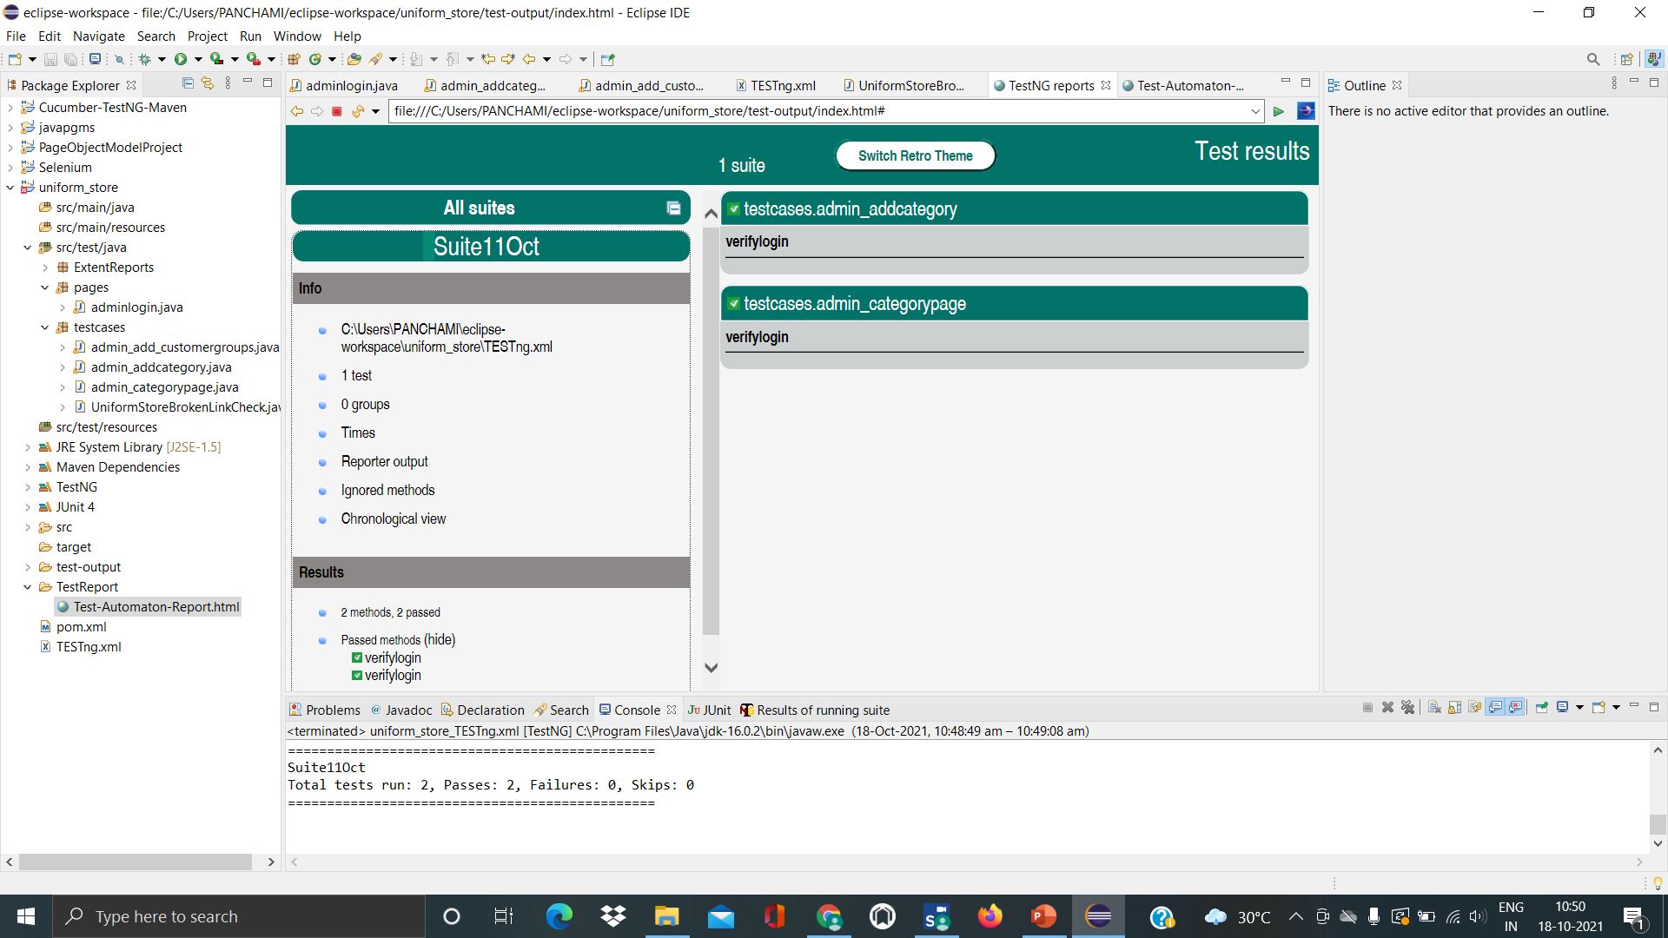
AUTOMATION TESTING – SPRINT 2

Slide 6
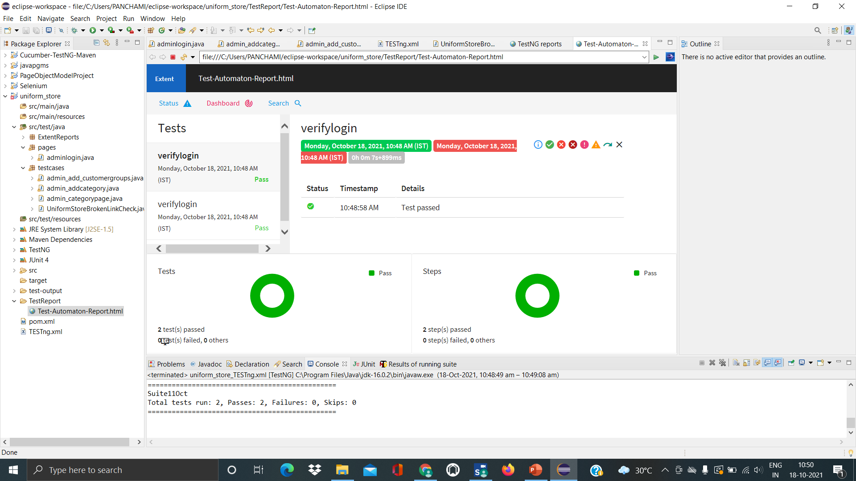
AUTOMATION TESTING – SPRINT 2

Slide 7
THANK YOU

